Slide 3
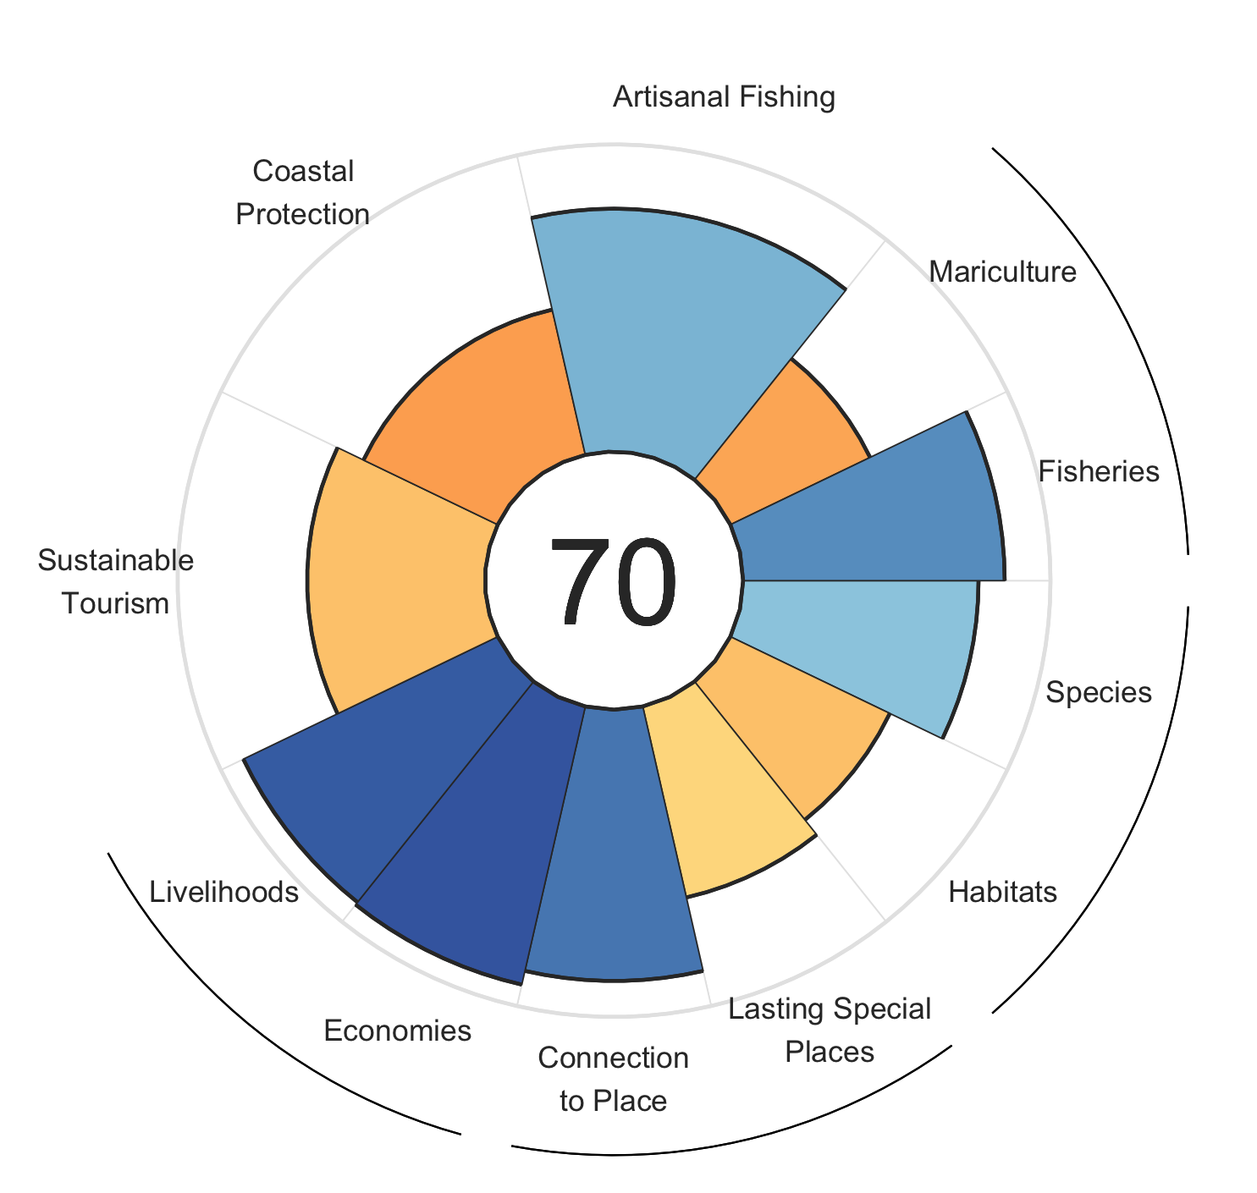







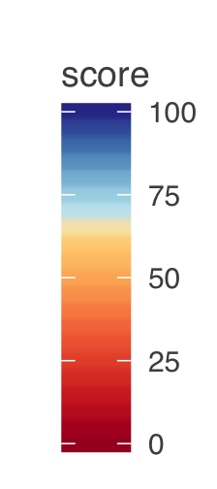
85 Wild Caught Fisheries
51 Mariculture
79 Artisan Fishing Opportunities
59 Habitats
77 Species
49 Coastal Protection
92 Livelihoods
92 Economies
58 Sustainable Tourism
64 Lasting Special Places
88 Connection to Place
Scores are from 0 to 100 and reflect the ability of our ocean to provide sustainable benefits to Hawaii now and into the future

Slide 4
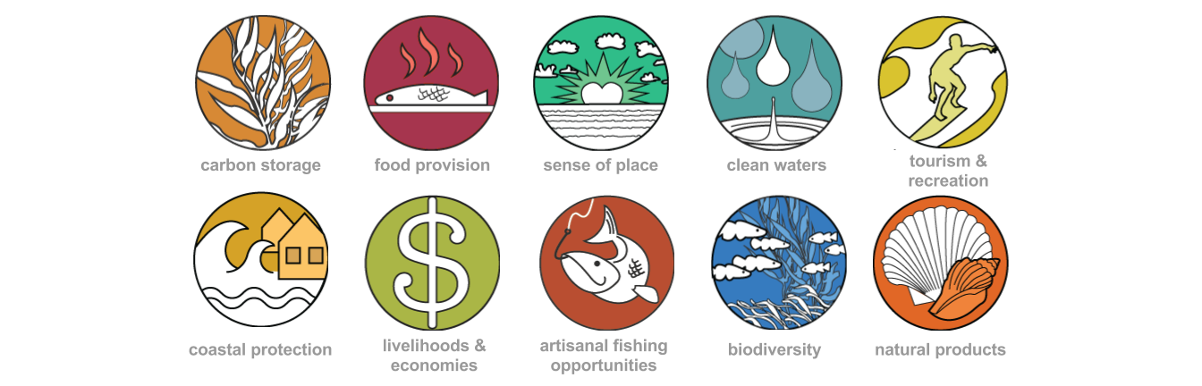
87

Slide 5
Food Provision
Artisanal Fishing Opportunities
Sense of Place
Sustainable Tourism
Biodiversity
Coastal Protection
Livelihoods & Economies

